Slide 1
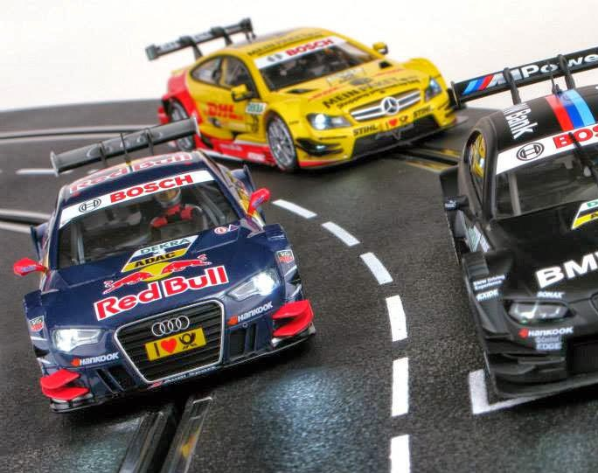
Using HTM to Perform Misbehavior Detection in Autonomous Vehicle Platoons
Ethan Swistak and Tushar Singhal

Slide 2
Week 12– Progress Summary
Completed This Week | To-Do
Tried retraining F2MD LSTM model, didn’t work out so well ☹ Ran HTM on Veremi dataset but categorical variable problem. Research on grid cells and tiling to solve issues with applying anomaly detection algorithms. Modified VeRemi dataset with groundtruth and tiles | Implement grid cells on HTM, test new model. Train LSTM-Autoencoder with tiled dataset for comparison. Compare to SOTA results. F2MD is probably outside the scope of the project, for now at least.

Slide 3
Tiling
For LSTM-Autoencoder we can tile the simulation space into grid cells that will allow us to gather more data about messages coming from the same regions with different cars.
This helps to avoid the fact that each car only has a very small sample size
Htm presents an additional problem, since we need a way to encode a spatial representation into a Sparse Distributed Representation

Slide 4
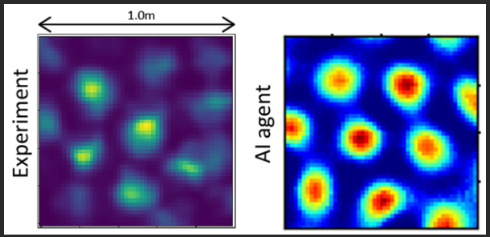
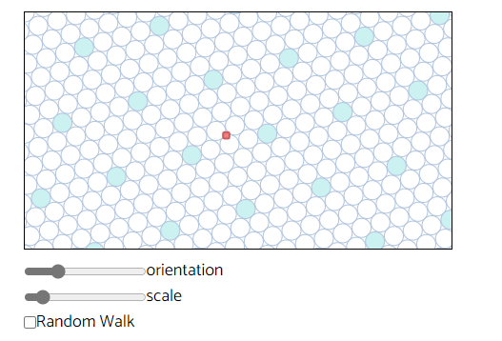
HTM Grid Cells
Grid cells are a more sophisticated way we can incorporate location data into an HTM model
A grid cell activates when the agent is close to certain location displaced out into a lattice structure
They were discovered recently in studies with mice where it was discovered that certain cells in the mouse hippocampus would fire when they were in different regions of their cage.

Slide 5
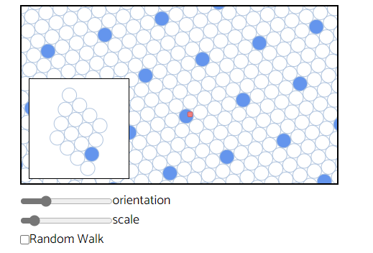
HTM grid Modules
A single grid cell does not tell us much about the single unique location of the agent but they can be grouped into modules
A module contains a number of grid cells arranged in the same scale and orientation
Modules ensure that there is always a cell active when the agent is in each location, but still do not completely disambiguate location

Slide 6
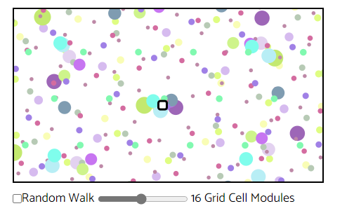
Multiple grid cell modules
A location can be disambiguated where multiple grid cells overlap
By using different scales and orientations a flexible, learnable, and unambiguous representation of space can be encoded
The more modules used, the more accurate the special location can be determined

Slide 7
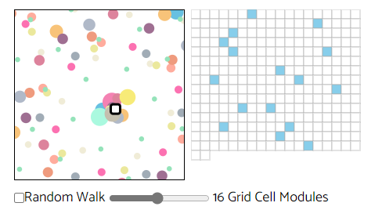
Encoding
Nupic contains an additional module to build a grid cell encoder specifically for this purpose
In the training phase clean data can be fed into the htm and then we can directly compare the performance of other methods
May also be useful in supplementing additional approaches used in the f2md framework

